Slide 1
Lab 5

Slide 2
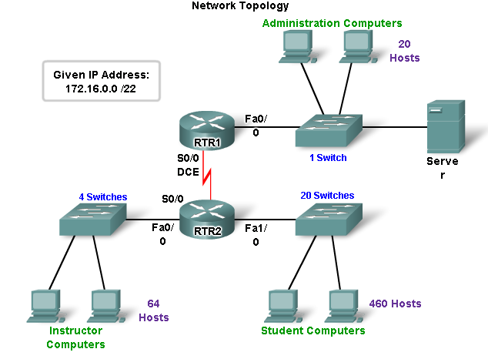
Addressing with VLSM

Slide 3
DHCP Parameters:
Students: Start IP: 0.2; SM: 255.255.254.0; SVR: 1.254; DNS: 8.8.8.8
DG: 0.1 → F0/1 (Router 2)
Instructors: Start IP: 2.2; SM: 255.255.255.128; SVR: 2.126; DNS: 8.8.8.8
DG: 2.1 → F0/0 (Router 2)
ADMIN: Start IP: 2.130; SM: 255.255.255.224; SVR: 2.158; DNS: 8.8.8.8
DG: 2.129 → F0/0 (Router 1)
Router 1 (S0/0/0): 2.161/30
Router 2 (S0/0/0): 2.162/30
//Default route routing
Router1(config)# ip route 0.0.0.0 0.0.0.0 172.16.2.162
Router2(config)# ip route 0.0.0.0 0.0.0.0 172.16.2.161

